Slide 1

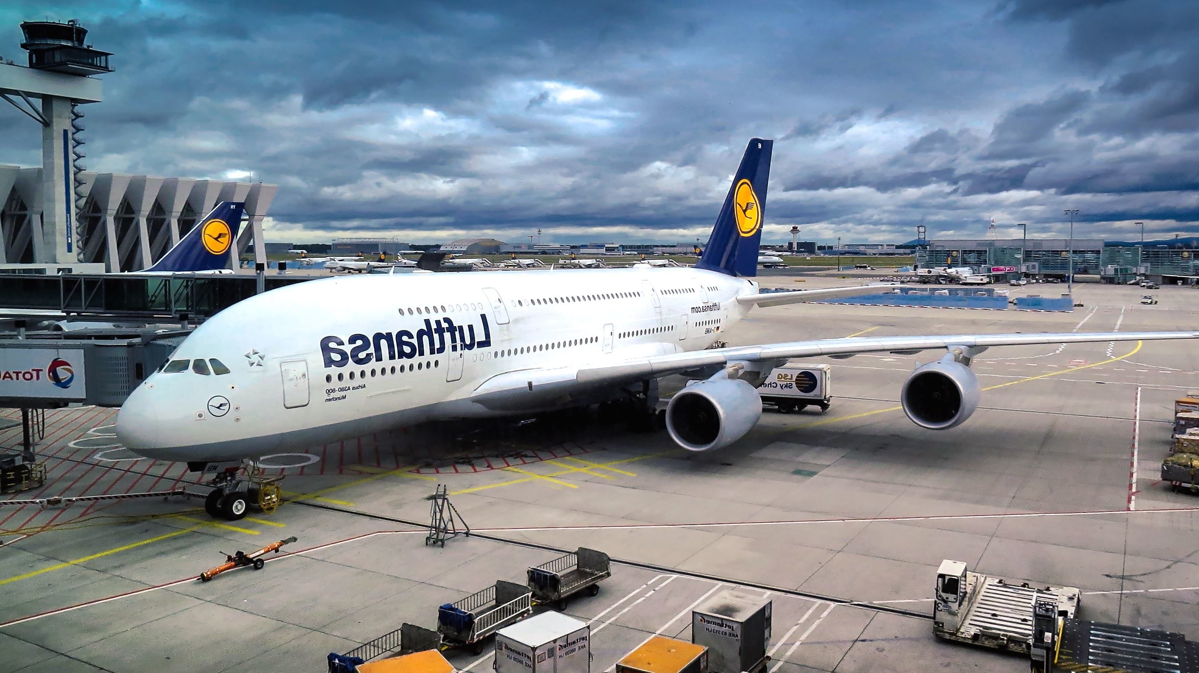
AIRLINE RESERVATION SYSTEM

Slide 2

Presented By: Nithin Kumar Pendam Batch: RDBMS (PL/SQL) Sep2nd Under the Guidance of: Ajay Kumar Nerumati Mentor: Devangana Mandal

Slide 3

Contents
OBJECTIVE
ABSTRACT
INTRODUCTION
SYSTEM REQUIREMENTS
DESIGN PHASE
DEVELOPMENT PHASE
SUMMARY

Slide 4

OBJECTIVE:
Designing the Database,
Developing the Queries & Basic Reports required for Airline Reservation System

Slide 5

ABSTRACT
Designing a Central
Air-Reservation Database to be used by all Booking Offices. This Database is to be used by Front End Systems and it also requires some Backend query and procedure designing.

Slide 6

INTRODUCTION
This Project is to Design the Database, Reports the queries related to Warehouse Airline Reservation System.

Slide 7


SYSTEM REQUIREMENTS
Physical Memory (RAM) 1GB Minimum
Disk Space Total 5GB
Processor 550 MHz Minimum
Video Adapter 256 Colors

Slide 8

DESIGN PHASE
Entity Relationship Diagram.
TABLE’s Used.

Slide 9
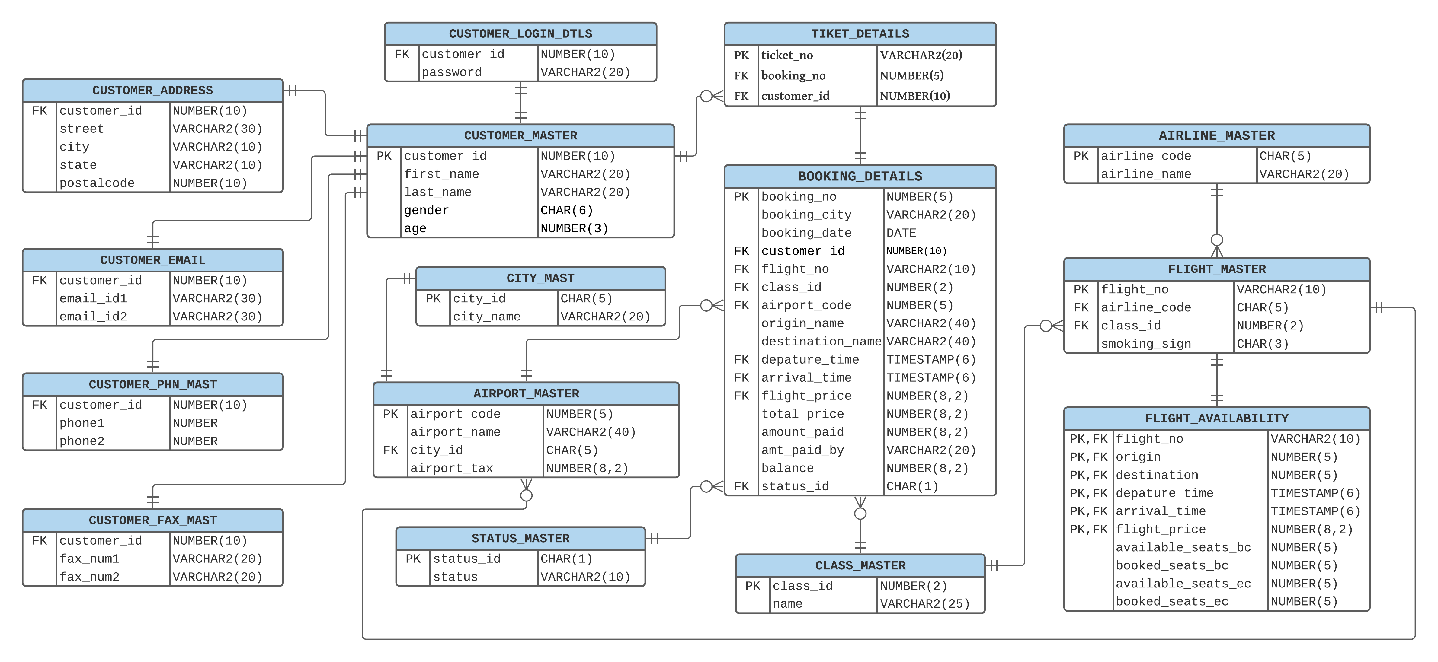
Entity Relationship Diagram

Slide 10
TABLES USED
CUSTOMER_MASTER
Customer_id | PRIMARY KEY | NUMBER(10)
First_name | NOT NULL | VARCHAR2(20)
Last_name | NOT NULL | VARCHAR2(20)
Gender |  | CHAR(6)
Age |  | NUMBER(3)
CUSTOMER_ADDRESS
Customer_id | FOREIGN KEY | NUMBER(10)
Street |  | VARCHAR2(30)
City |  | VARCHAR2(10)
State |  | VARCHAR2(10)
Postalcode |  | NUMBER(10)
CUSTOMER_FAX_MAST
Customer_id | FOREIGN KEY | NUMBER(10)
Fax_num1 | NOT NULL | VARCHAR2(20)
Fax_num2 |  | VARCHAR2(20)
CUSTOMER_PHN_MAST
Customer_id | FOREIGN KEY | NUMBER(10)
Phone1 | NOT NULL | NUMBER(10)
Phone2 |  | NUMBER(10)

Slide 11
TABLES USED (Continue..)
CUSTOMER_EMAIL
Customer_id | FOREIGN KEY | NUMBER(10)
Email_id1 | NOT NULL | VARCHAR2(30)
Email_id2 |  | VARCHAR2(30)
CUSTOMER_LOGIN_DTLS
Customer_id | FOREIGN KEY | NUMBER(10)
Password | NOT NULL | VARCHAR2(20)
STATUS_MASTER
Status_id | PRIMARY KEY | CHAR(1)
Status |  | VARCHAR2(10)
CITY_MAST
City_id | PRIMARY KEY | CHAR(5)
City_name |  | VARCHAR2(20)
CLASS_MASTER
Class_id | PRIMARY KEY | NUMBER(2)
Name |  | VARCHAR2(30)

Slide 12
TABLES USED (Continue..)
AIRLINE_MASTER
Airline_code | PRIMARY KEY | CHAR(5)
Airline_name |  | VARCHAR2(20)
FLIGHT_MASTER
Flight_no | PRIMARY KEY | VARCHAR2(20)
Airline_code | FOREIGN KEY | CHAR(5)
Class_id | FOREIGN KEY | NUMBER(2)
Smoking_sign |  | CHAR(3)
AIRPORT_MASTER
Airport_code | PRIMARY KEY | NUMBER(5)
Airpot_name |  | VARCHAR2(40)
City_id | FOREIGN KEY | CHAR(5)
Airport_tax |  | NUMBER(8,2)

Slide 13
TABLES USED (Continue..)
FLIGHT_AVAILABILITY
Flight_no | FOREIGN KEY, PRIMARY KEY | VARCHAR2(10)
Origin | FOREIGN KEY, PRIMARY KEY | NUMBER(5)
Destination | FOREIGN KEY, PRIMARY KEY | NUMBER(5)
Depature_time | PRIMARY KEY | TIMESTAMP
Arrival_time | PRIMARY KEY | TIMESTAMP
Flight_price | PRIMARY KEY | NUMBER(8,2)
Available_Seats_bc |  | NUMBER(5)
Booked_seats_bc |  | NUMBER(5)
Available_seats_ec |  | NUMBER(5)
Booked_seats_ec |  | NUMBER(5)
TICKET_DETAILS
Ticket_no | PRIMARY KEY | VARCHAR2(20)
Booking_no | FOREIGN KEY | NUMBER(5)
Customer_id | FOREIGN KEY | NUMBER(5)

Slide 14
TABLES USED (Continue..)
BOOKING_DETAILS
Booking_no | PRIMARY KEY | NUMBER(5)
Booking_city |  | VARCHAR2(20)
Booking_date | NOT NULL | DATE
Customer_id | FOREIGN KEY | NUMBER(10)
Flight_no | FOREIGN KEY | VARCHAR2(10)
Class_id | FOREIGN KEY | NUMBER(2)
Airport_code | FOREIGN KEY | NUMBER(5)
Origin_Name | NOT NULL | VARCHAR2(40)
Destination_name | NOT NULL | VARCHAR2(40)
Depature_time | NOT NULL | TIMESTAMP
Arrival_time | NOT NULL | TIMESTAMP
Flight_price | NOT NULL | NUMBER(8,2)
Total_price | NOT NULL | NUMBER(8,2)
Amount_paid |  | NUMBER(8,2)
Amt_paid_by | NOT NULL | VARCHAR2(20)
Balance |  | NUMBER(8,2)
Status_id | FOREIGN KEY | CHAR(1)

Slide 15
DEVELOPMENT PHASE
1.SQL
DQL, DDL, DML, TCL, DCL
JOINS & SUBQUERIES
2.PL/SQL
PROCEDURES
EXCEPTION HANDLINGS
FUNCTIONS
CURSORS
TRIGGERS

Slide 16
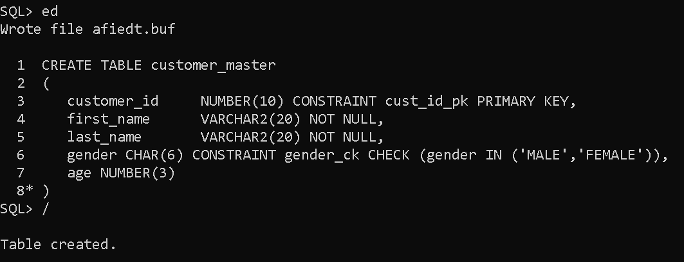
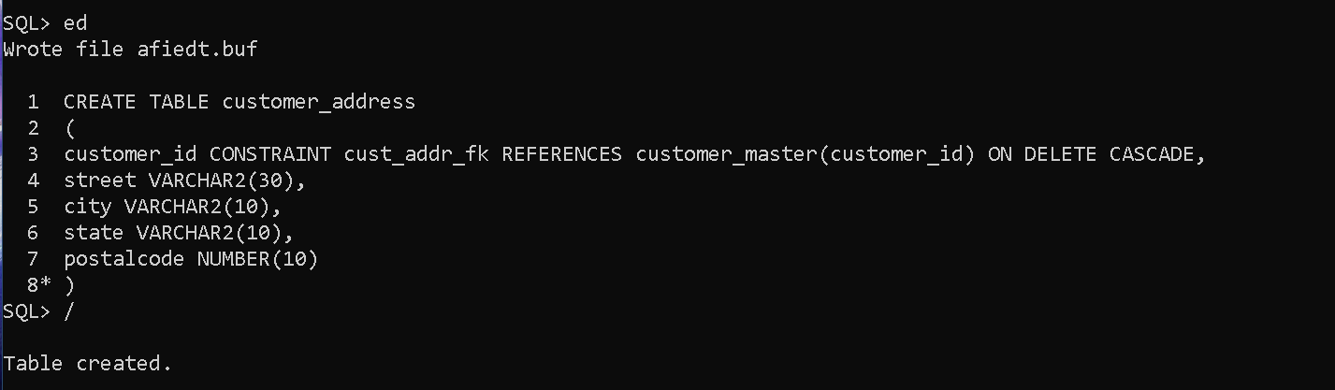
[CODING] TABLE CREATION:
Customer Master TABLE Creation:-
Customer Address TABLE Creation:-

Slide 17
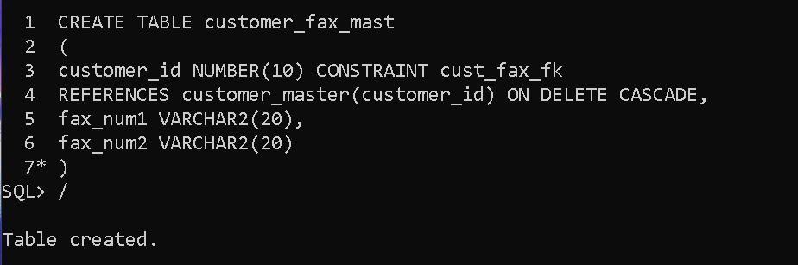
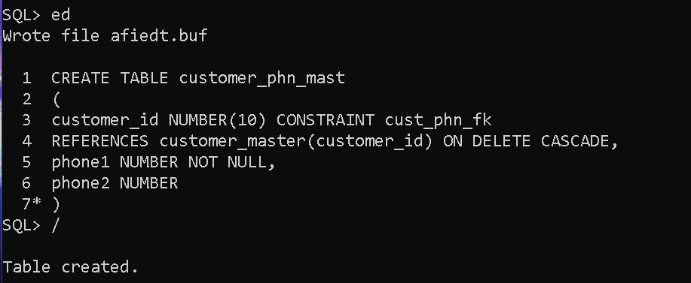
TABLE CREATION (Continue..):
Customer Fax Master TABLE Creation:-
Customer Phone Master TABLE Creation:-

Slide 18
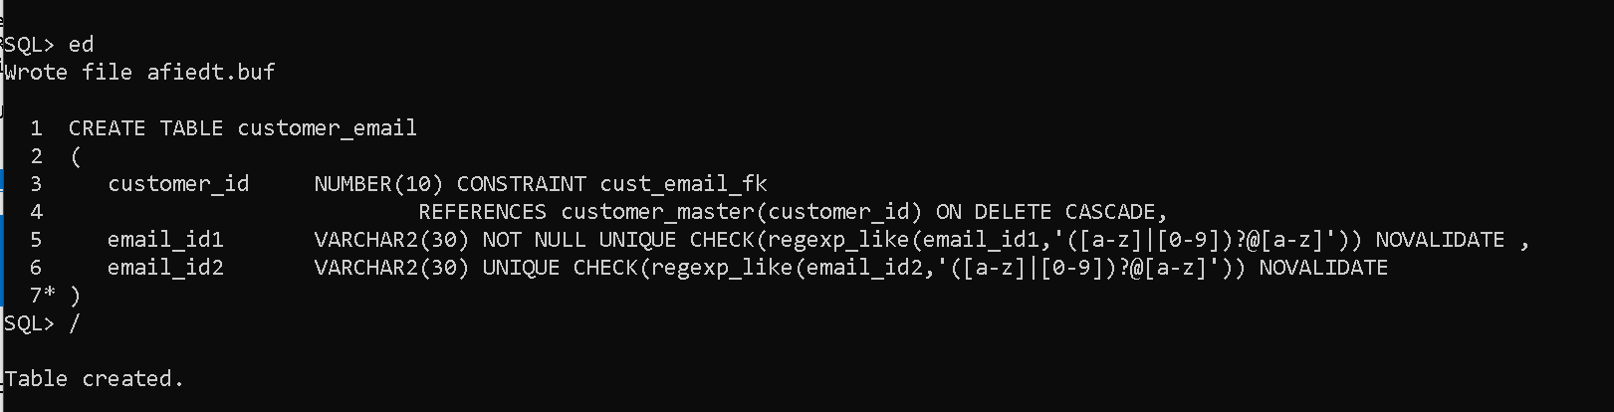
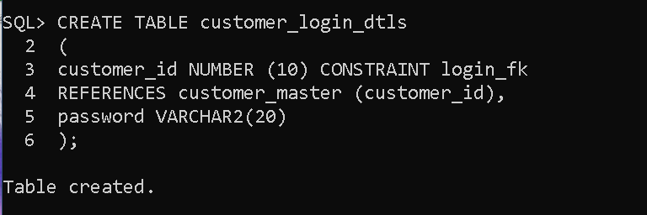
TABLE CREATION (Continue..):
Customer EmailID Master TABLE Creation:-
Customer Login Details TABLE Creation:-

Slide 19
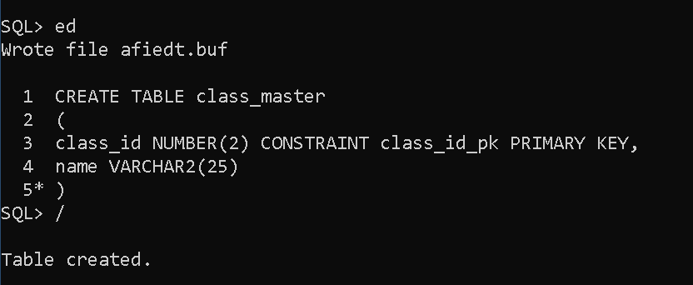
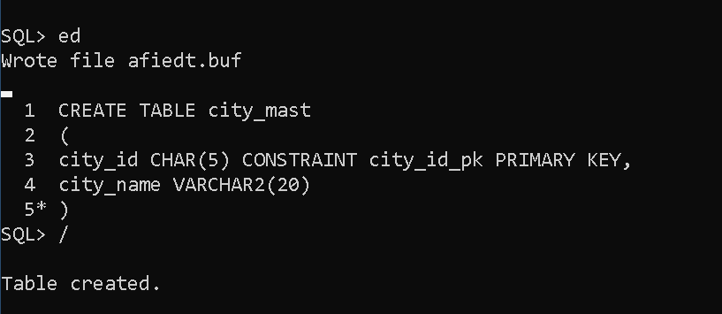
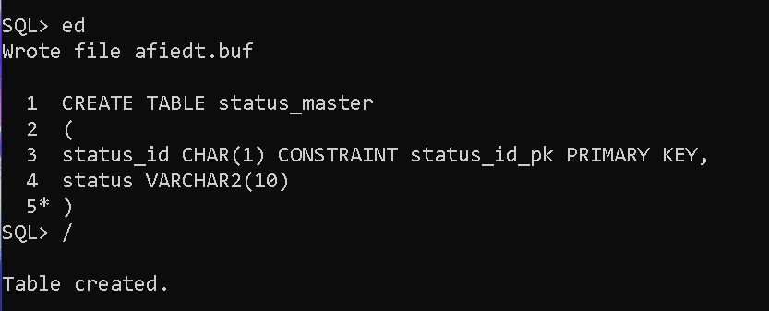
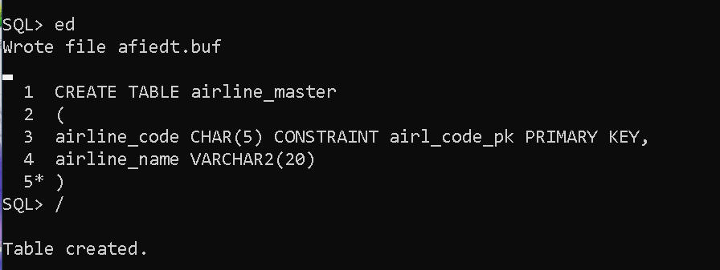
TABLE CREATION (Continue..):
Class Master TABLE Creation:-
City Master TABLE Creation:-
Airline Master TABLE Creation:-
Status Master TABLE Creation:-

Slide 20
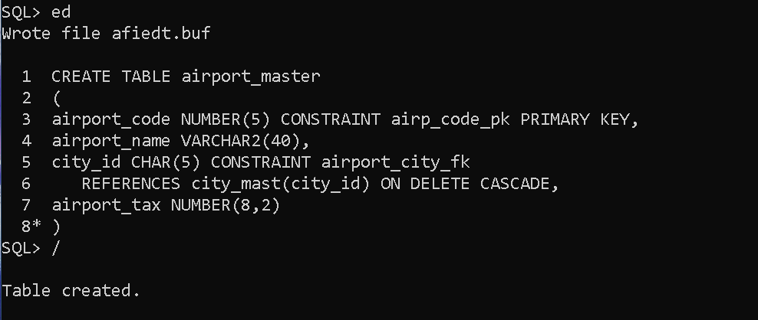
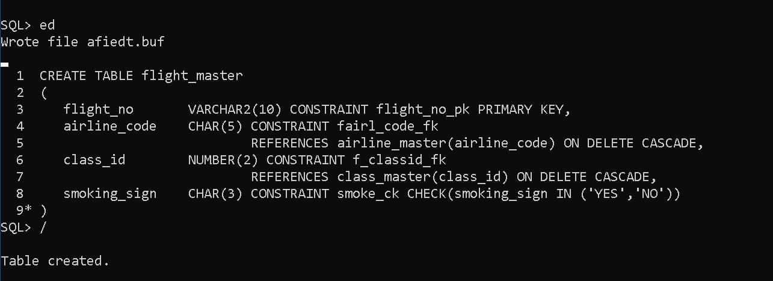
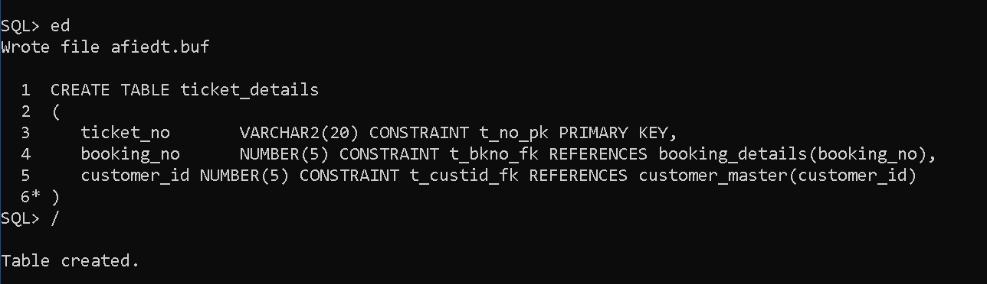
TABLE CREATION (Continue..):
Flight Master TABLE Creation:-
Airport Master TABLE Creation:-
Ticket Details TABLE Creation:-

Slide 21
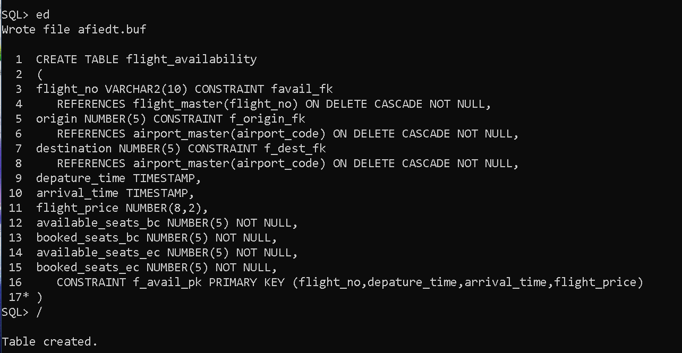
TABLE CREATION (Continue..):
Flight Availability TABLE Creation:-

Slide 22
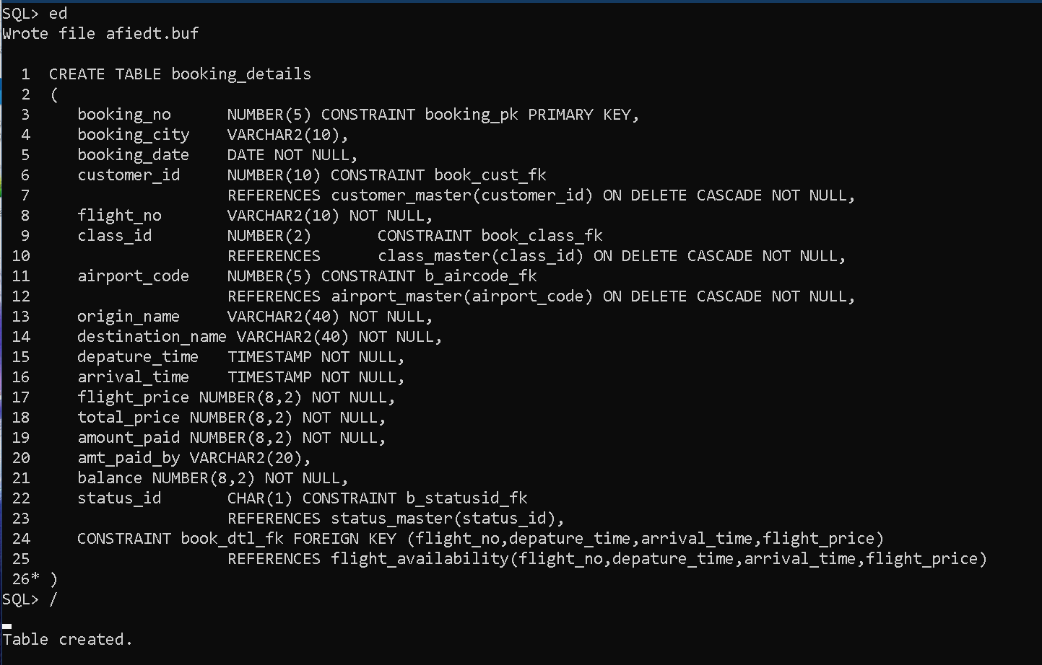
TABLE CREATION (Continue..):
Booking Details TABLE Creation:-

Slide 23
PROCEDURE 1:
Create a Procedure which gets Number_of_Bookings, Number_of_Emails, Number_of_Phones and Number_of_Faxes for each Customer. Customer_ID will be the Input to the Procedure.

Slide 24
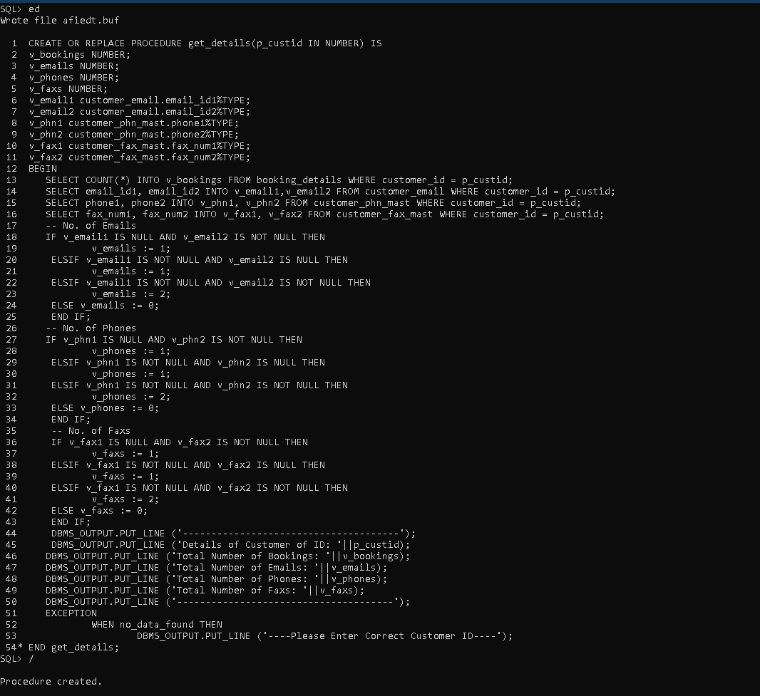
Procedure-1 Creation:

Slide 25
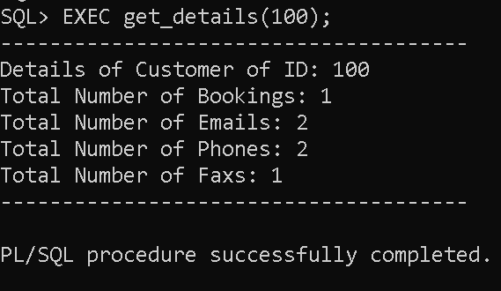
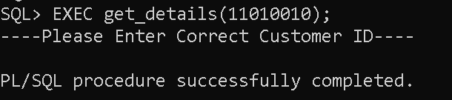
OUTPUT:-
-> Testing Output with Correct Inputs:
-> Testing Output with Wrong Inputs:

Slide 26
PROCEDURE 2:
Create a Procedure which Display all Customer’s First_name, Last_name, Phone_no’s and Email’s, sort them by Customer_ID. Customer_ID will be the input to the Procedure.

Slide 27
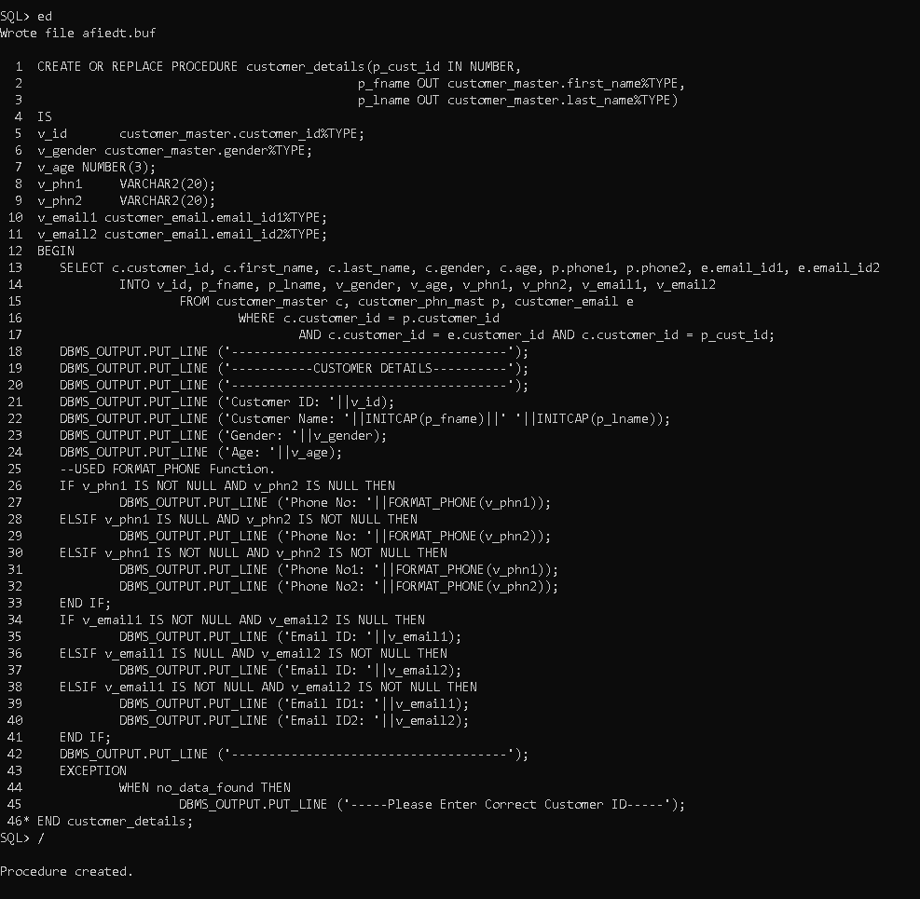
Procedure-2 Creation:

Slide 28
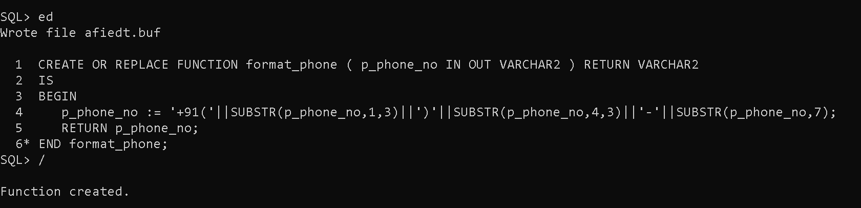
Function used in Procedure-2:

Slide 29
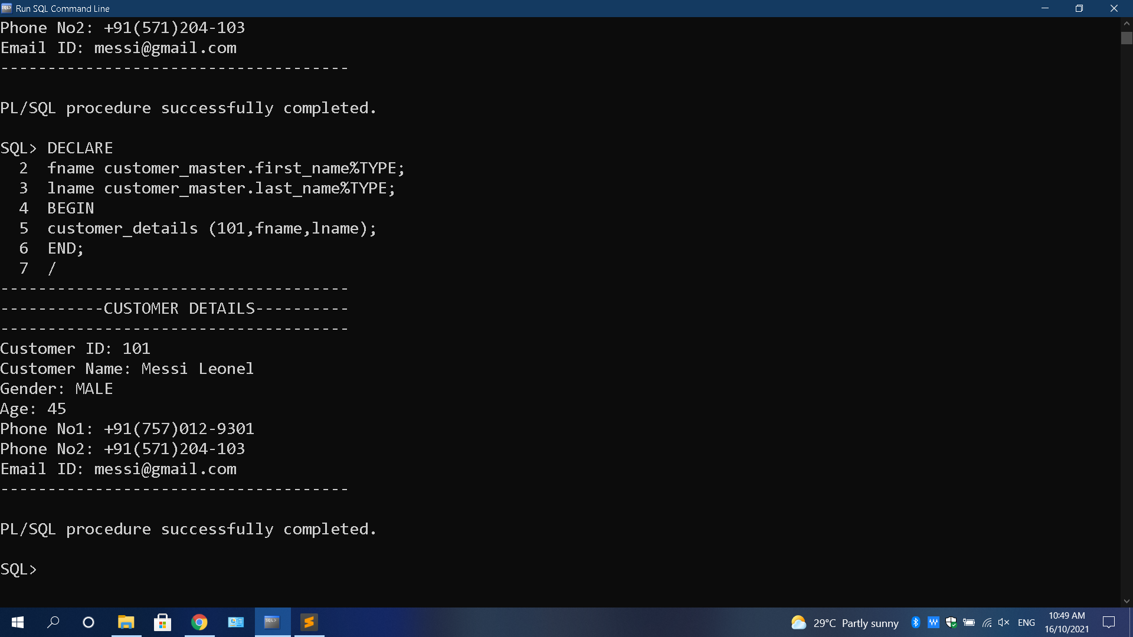
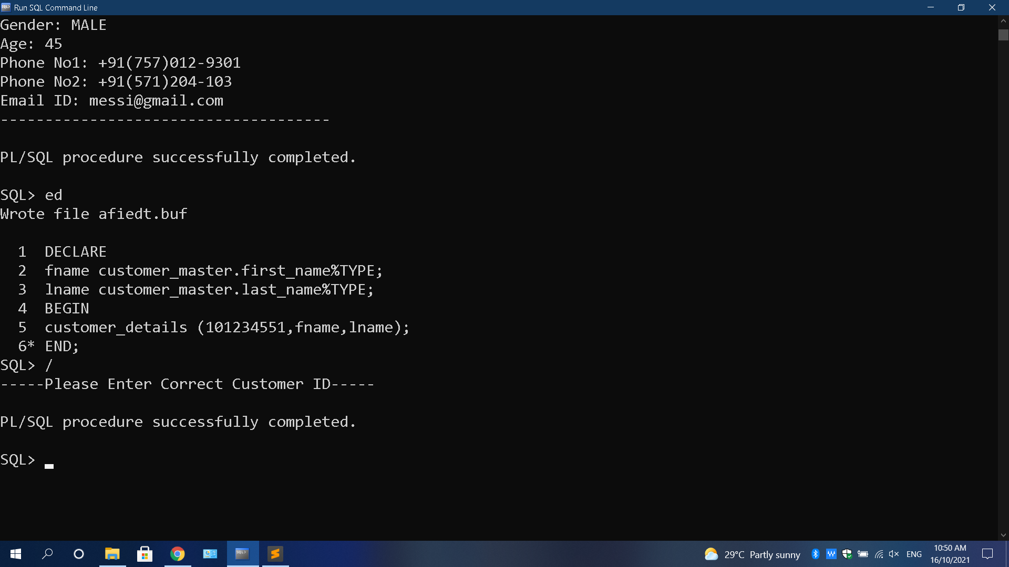
OUTPUT:-
-> Testing Output with Correct Inputs:
-> Testing Output with Wrong Inputs:

Slide 30
PROCEDURE 3:
Create a Procedure which will give list of all Customer’s who did not place any Booking’s.

Slide 31
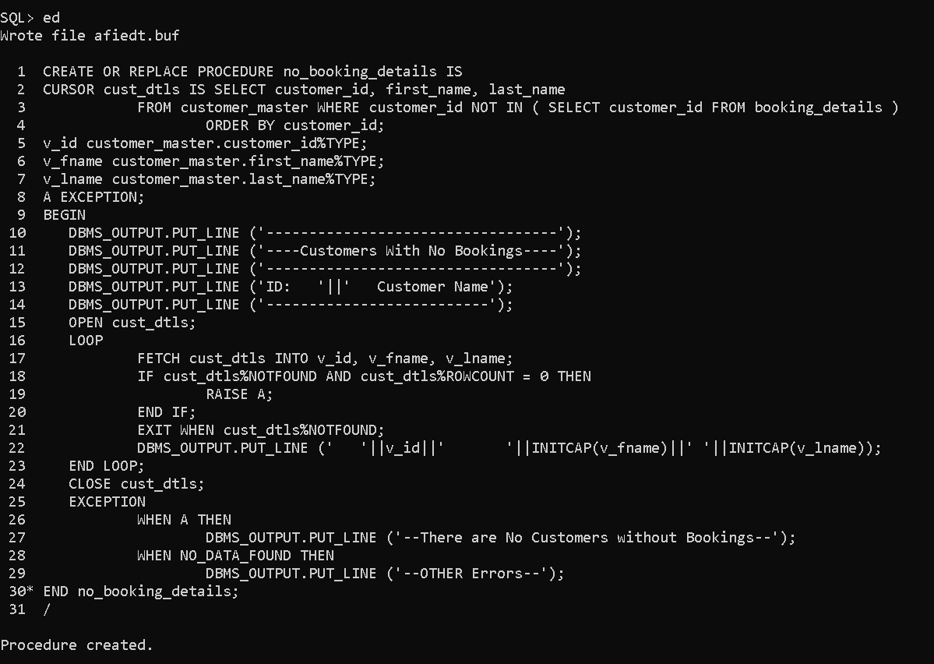
Procedure-3
Creation:

Slide 32
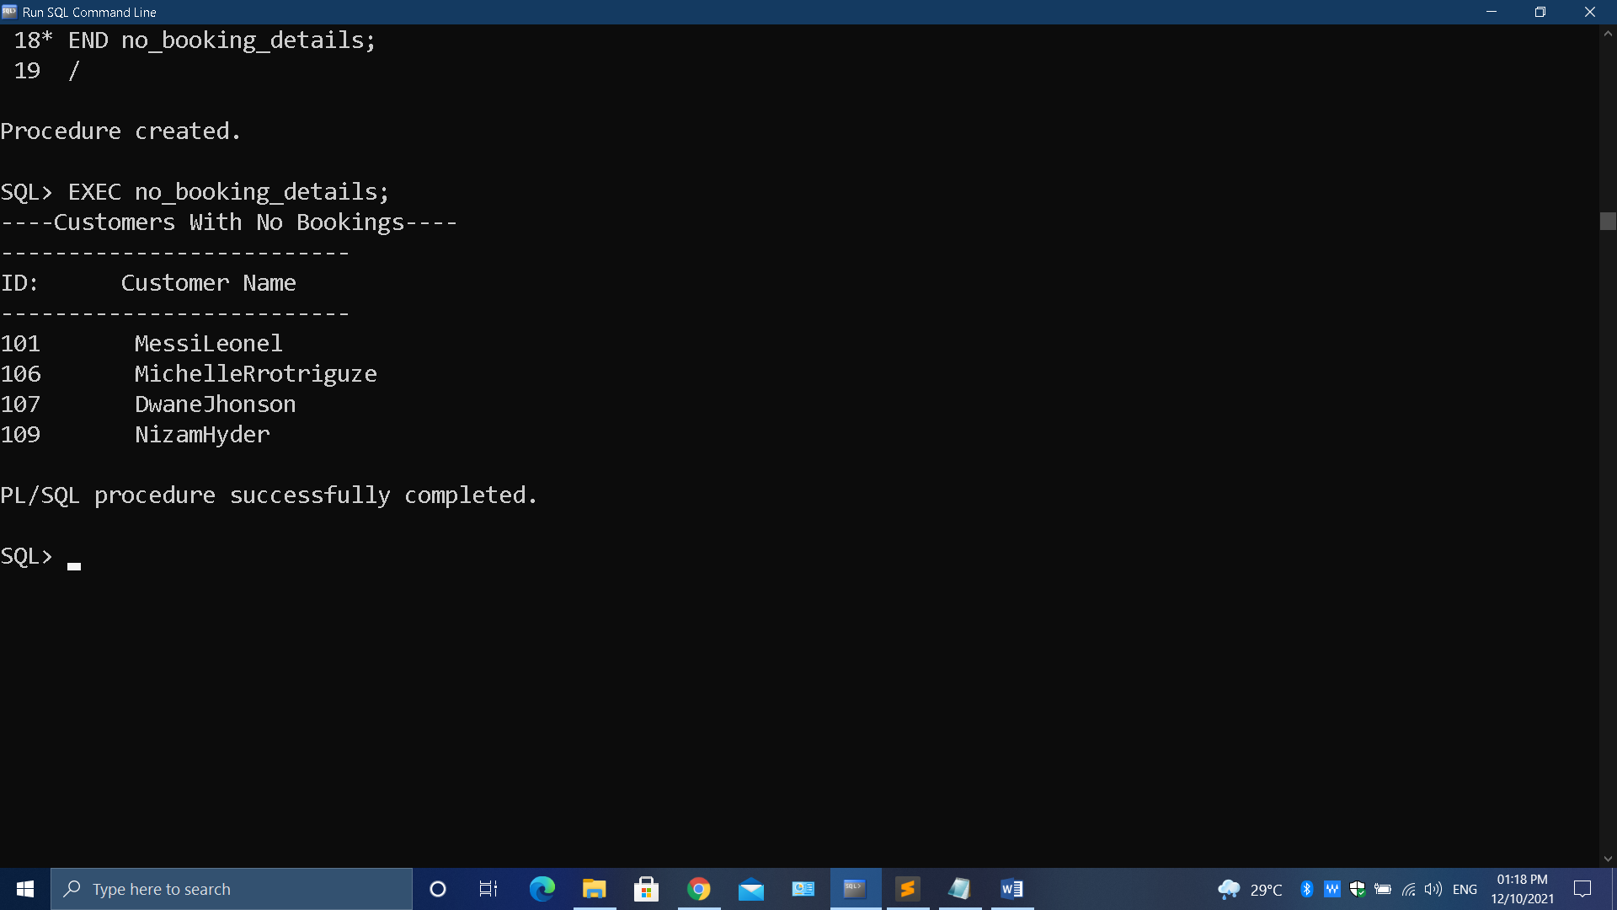
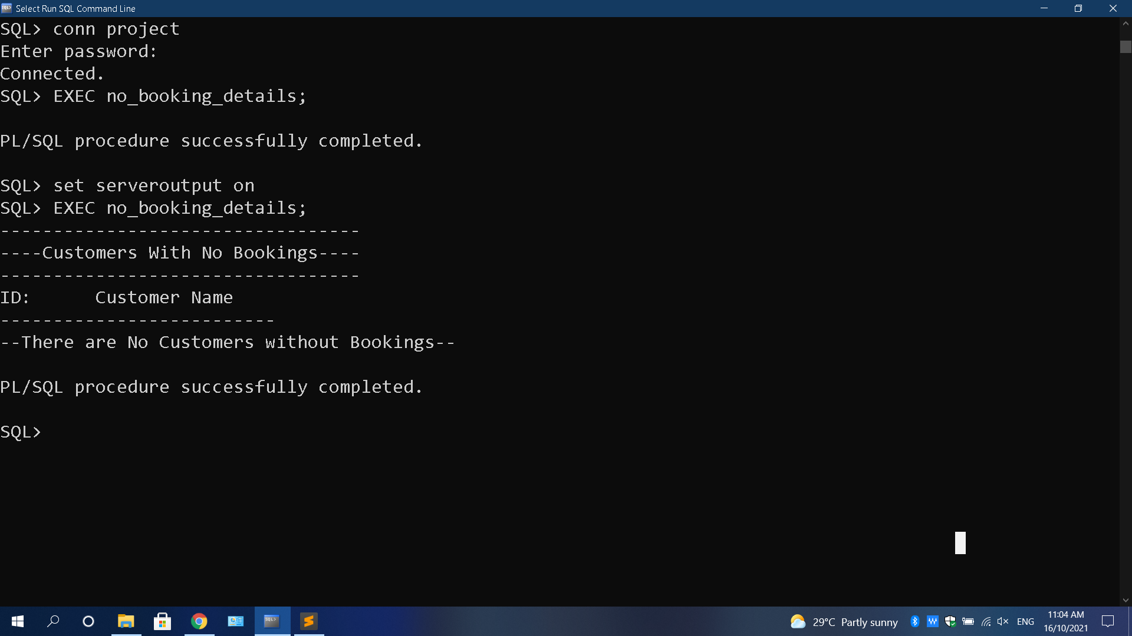
OUTPUT:-
-> Testing Output with Correct Data:
-> Testing Output with Wrong Data:

Slide 33
PROCEDURE 4:
Create a Procedure which will list of all Cancelled Booking’s, Please display Booking_no, Customer_id, Flight_no, Origin, Destination, Booking_city. Also sort by Booking_no, Customer_id and Flight_no.

Slide 34
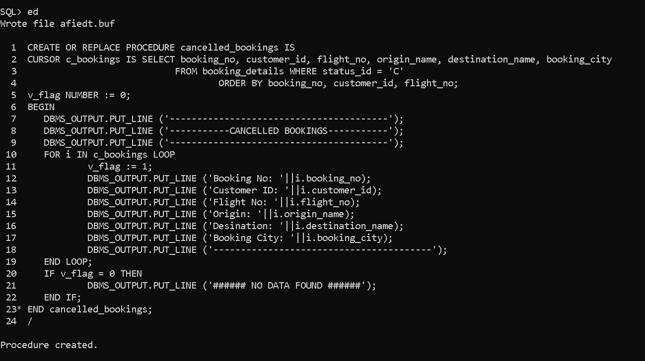
Procedure-4 Creation:

Slide 35
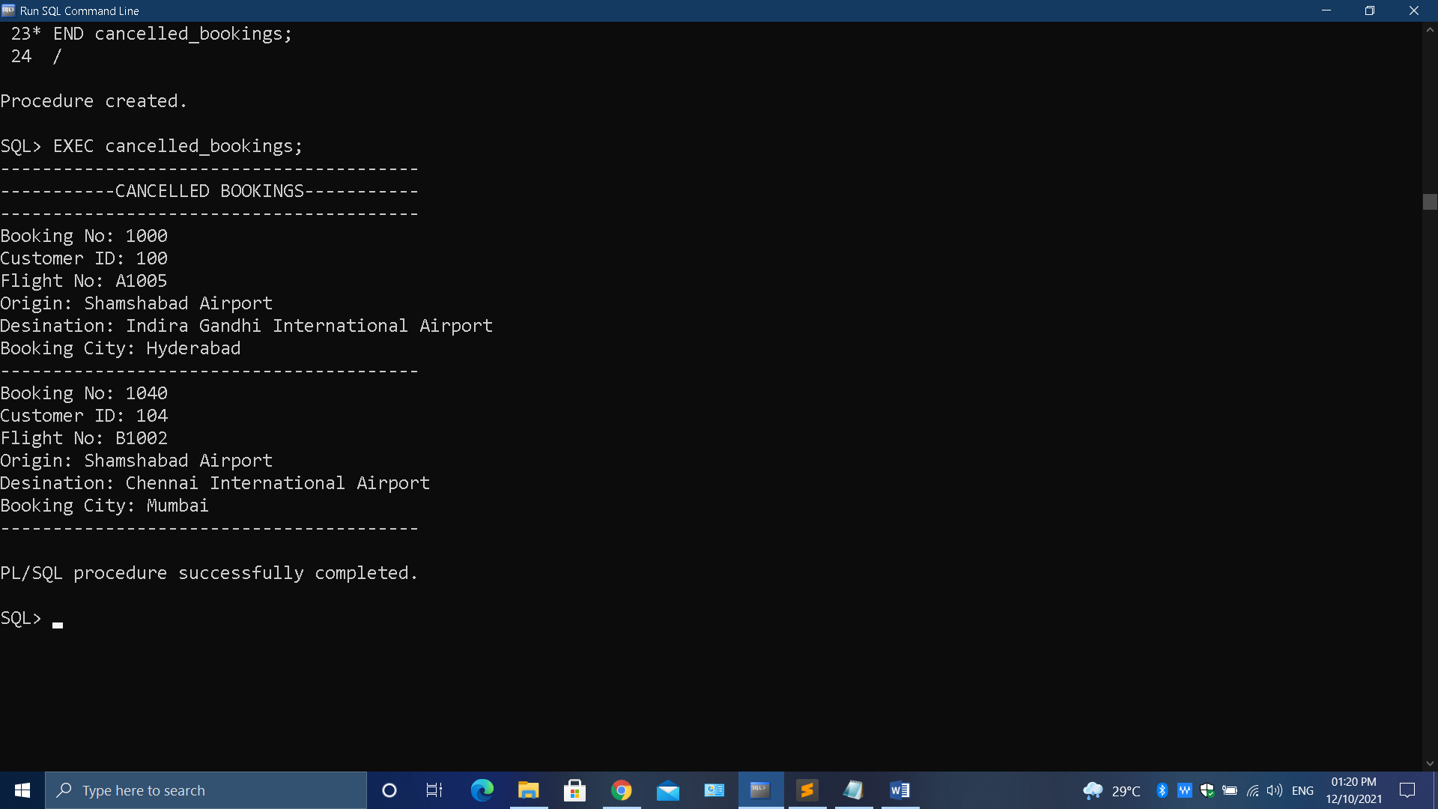
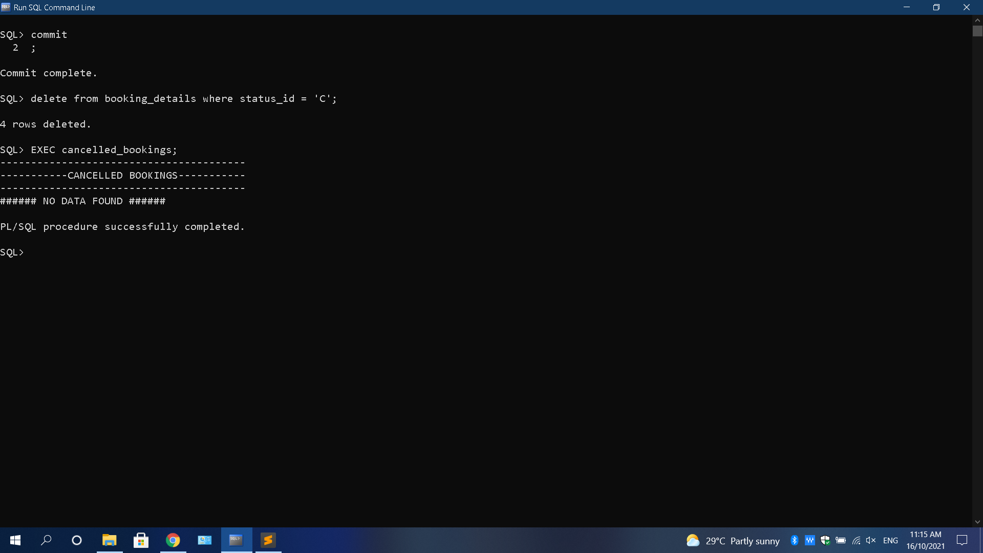
OUTPUT:-
-> Testing Output with Correct Data:
-> Testing Output with Wrong Data:

Slide 36
PROCEDURE 5:
Create a Procedure which do Transaction Processing i.e, a Customer must able to Book the Flight and the effects must go to Respective TABLE’s.

Slide 37
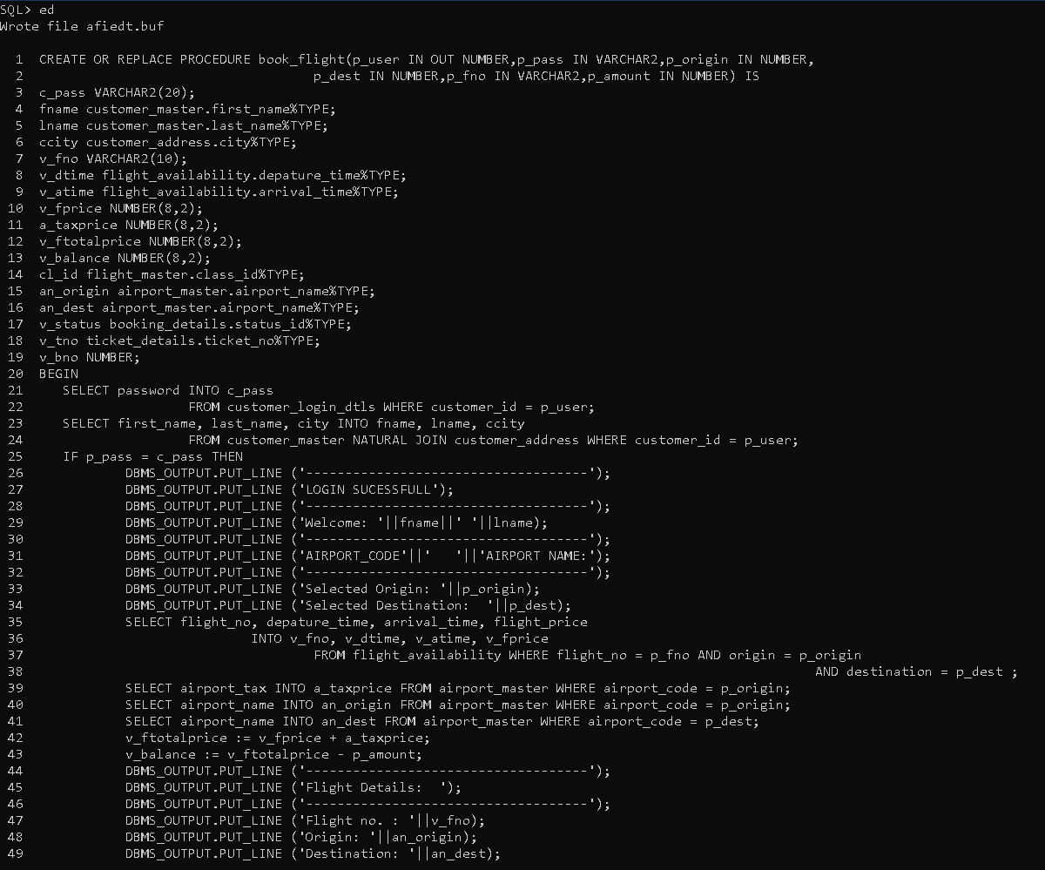
Procedure-5 Creation:-

Slide 38
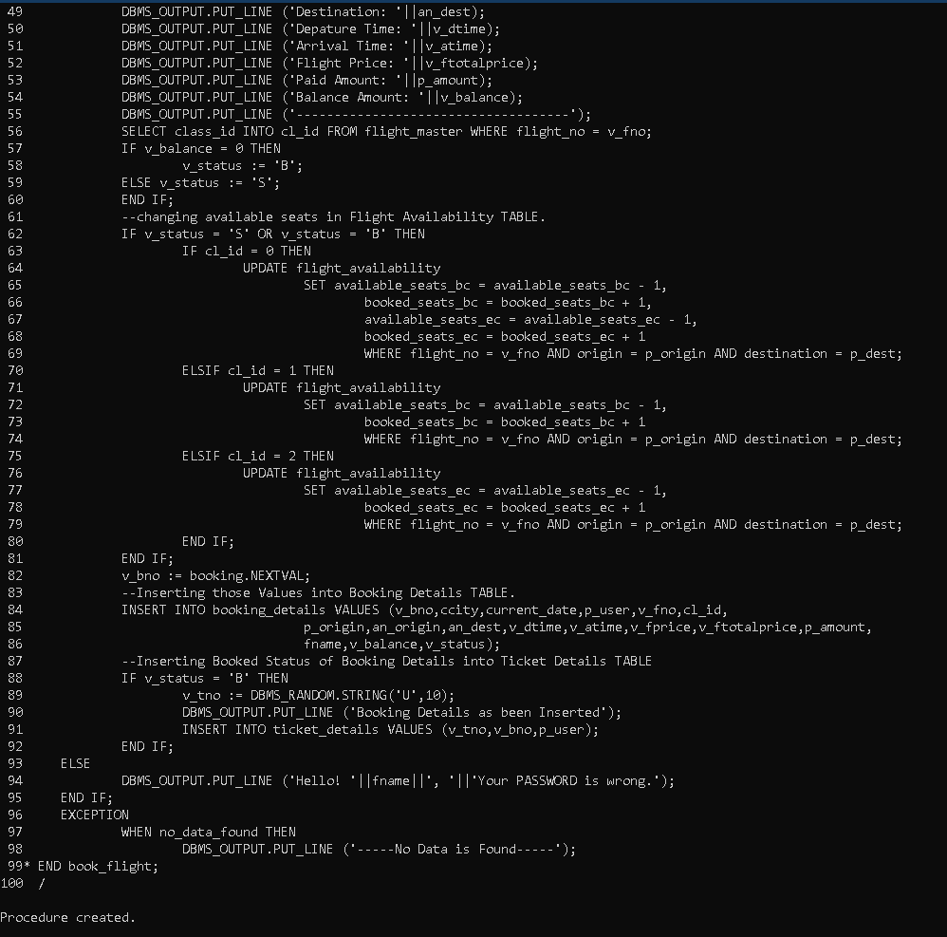
Continue..

Slide 39
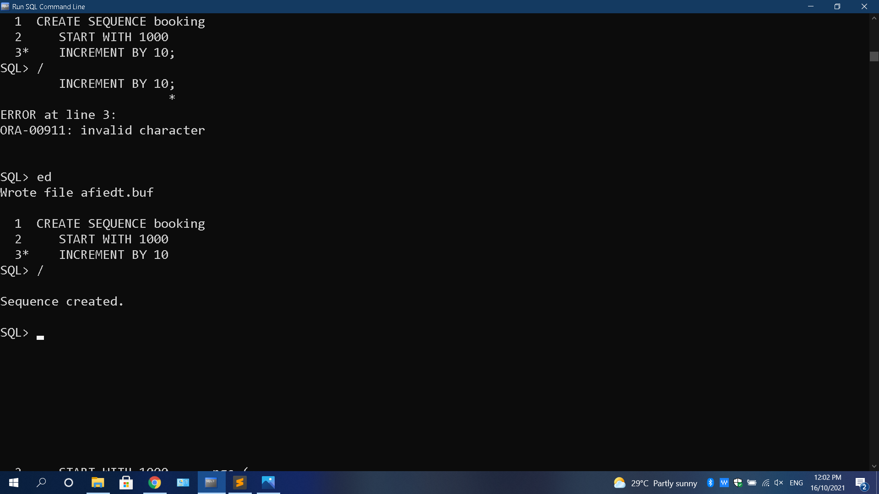
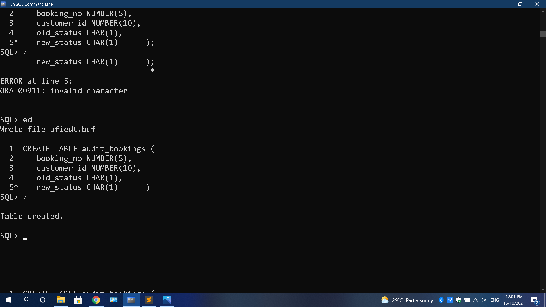
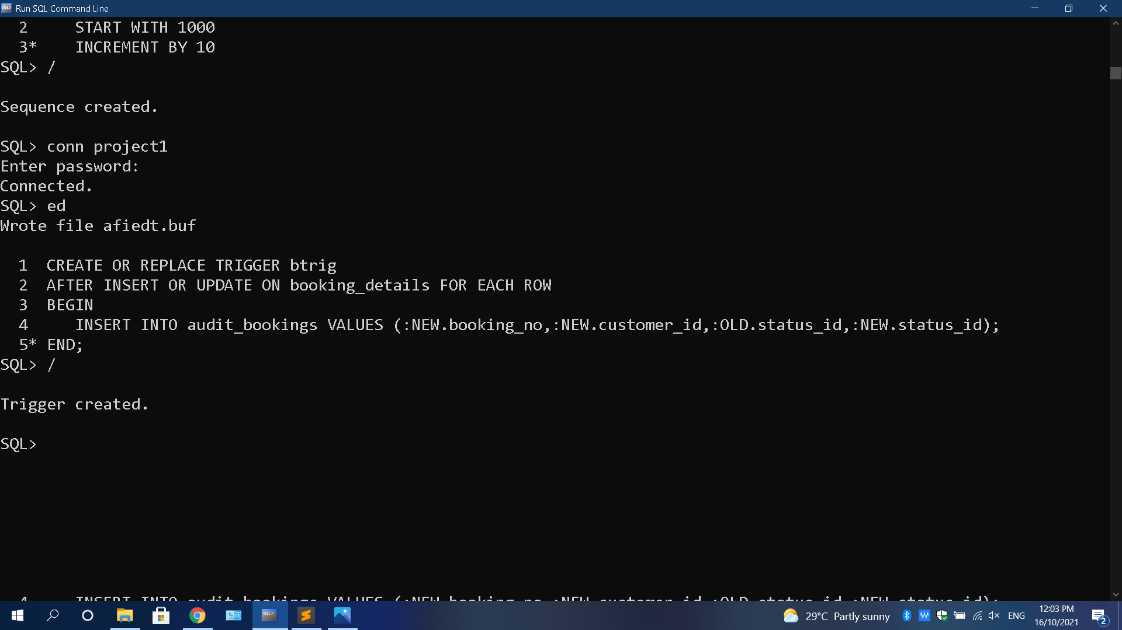
Sequence Used in Procedure 5:
Trigger TABLE:
Trigger Used in Procedure 5:

Slide 40
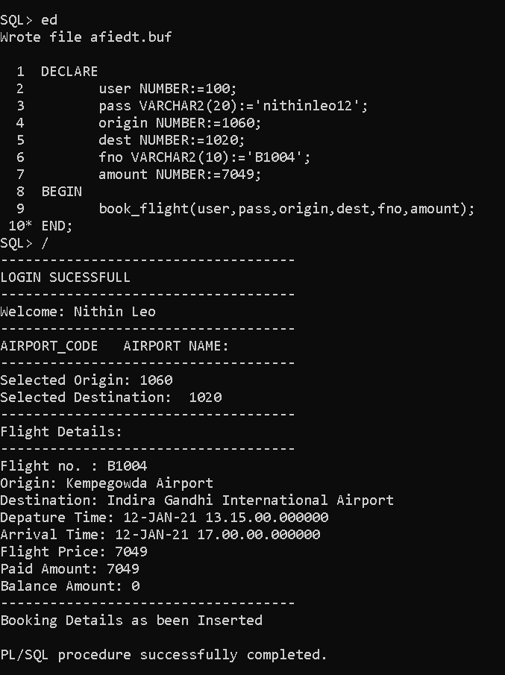
OUTPUT:-
-> Testing Output with Correct Inputs:

Slide 41
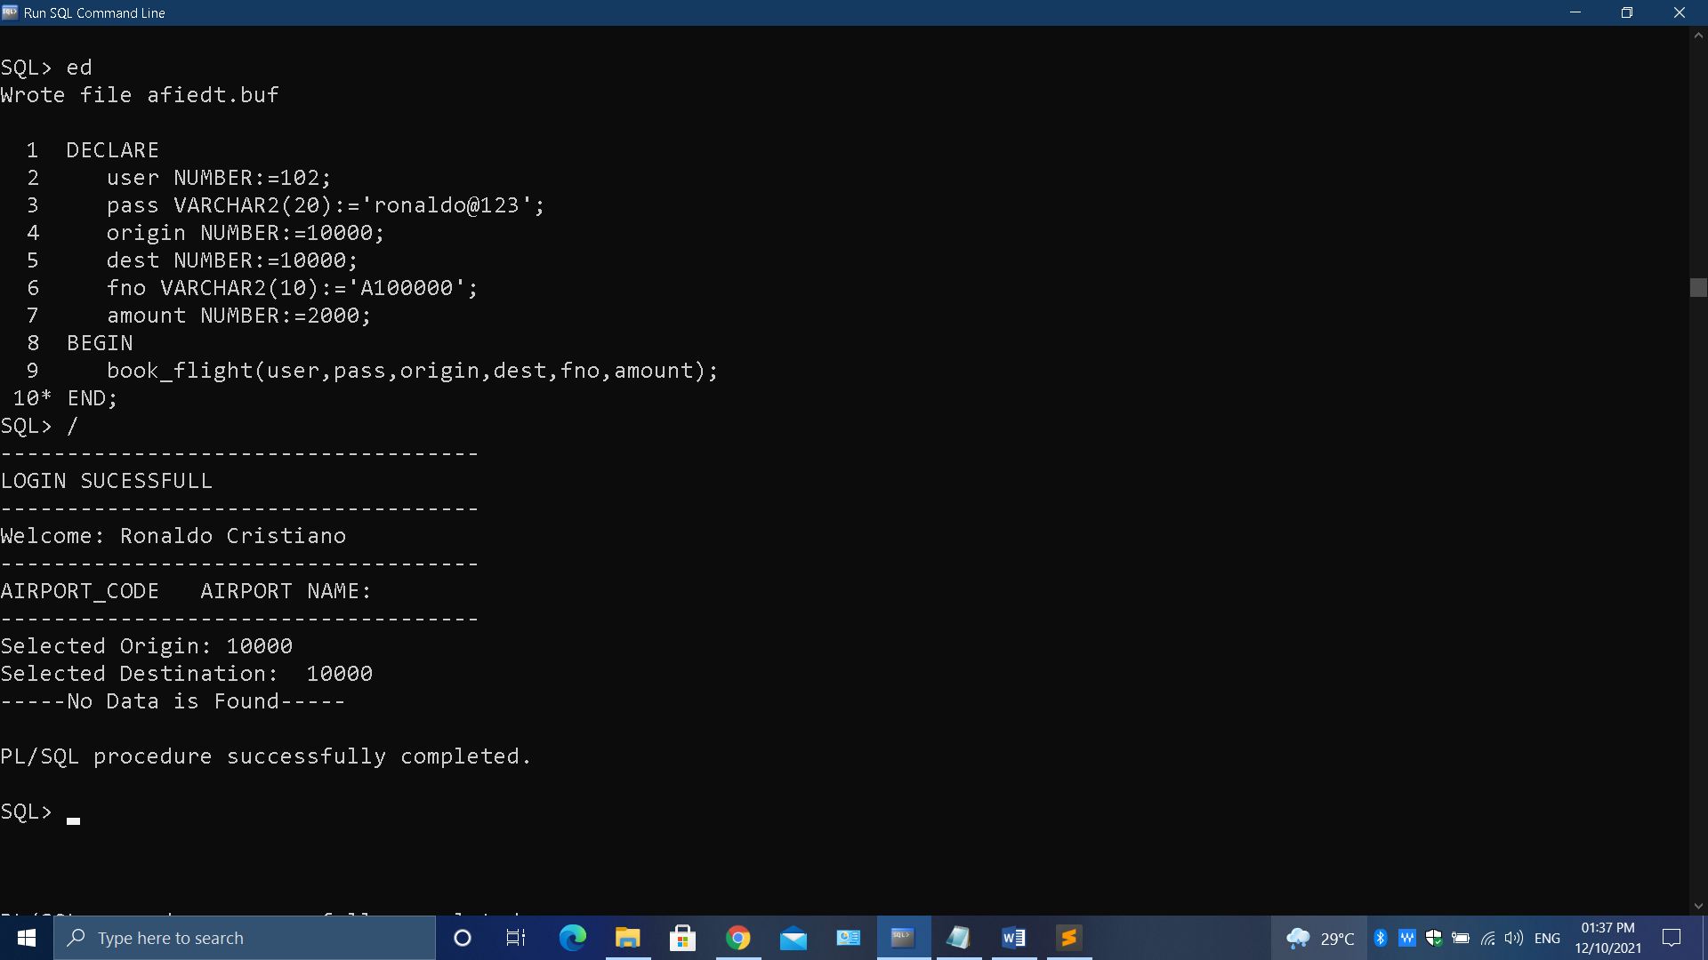
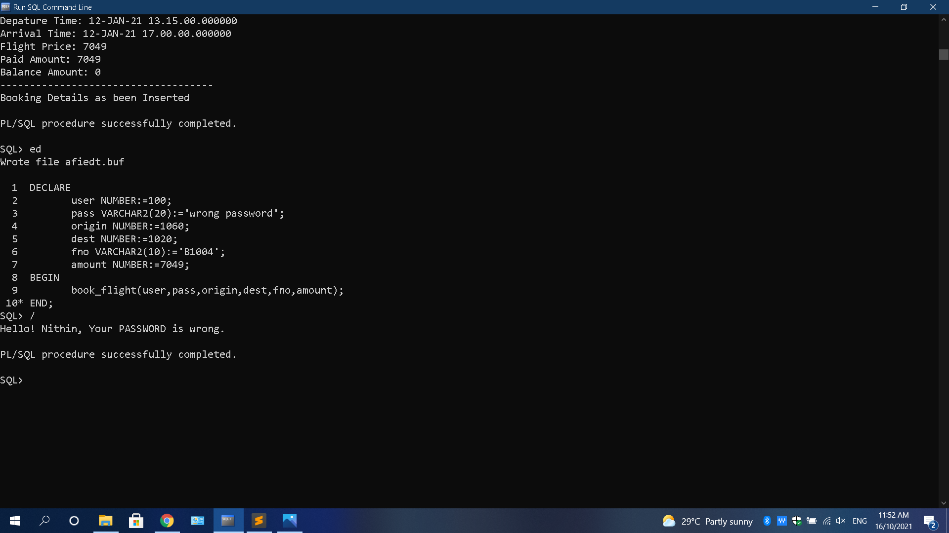
OUTPUT (Continue..):-
->Testing Output with Wrong Data:
-> Testing Output with Wrong Password:

Slide 42
PROCEDURE 6:
Create a Procedure which do Transaction Processing i.e, a Customer must able to Cancel the Flight and the effects must go to Respective TABLE’s.

Slide 43
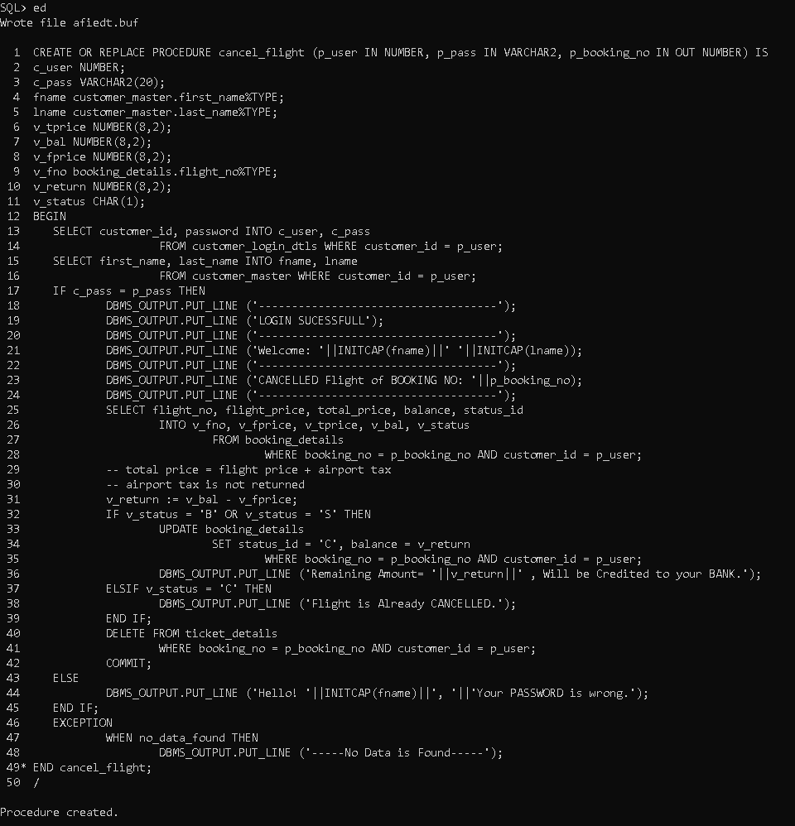
Procedure-6 Creation:

Slide 44
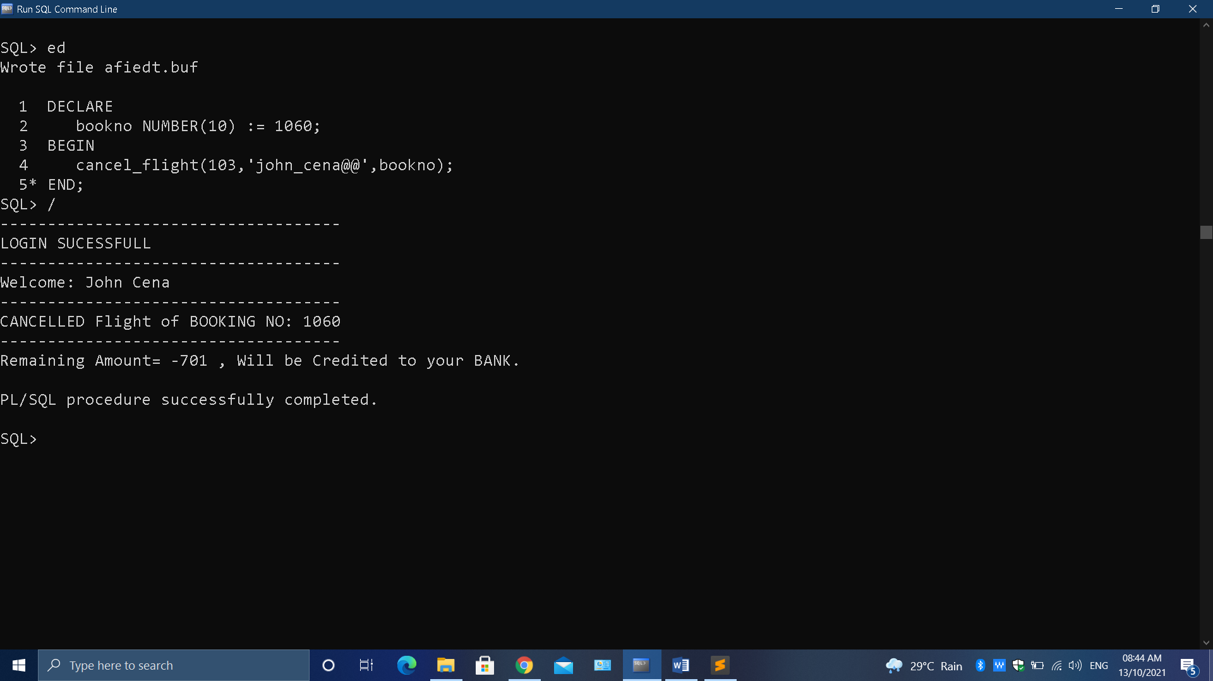
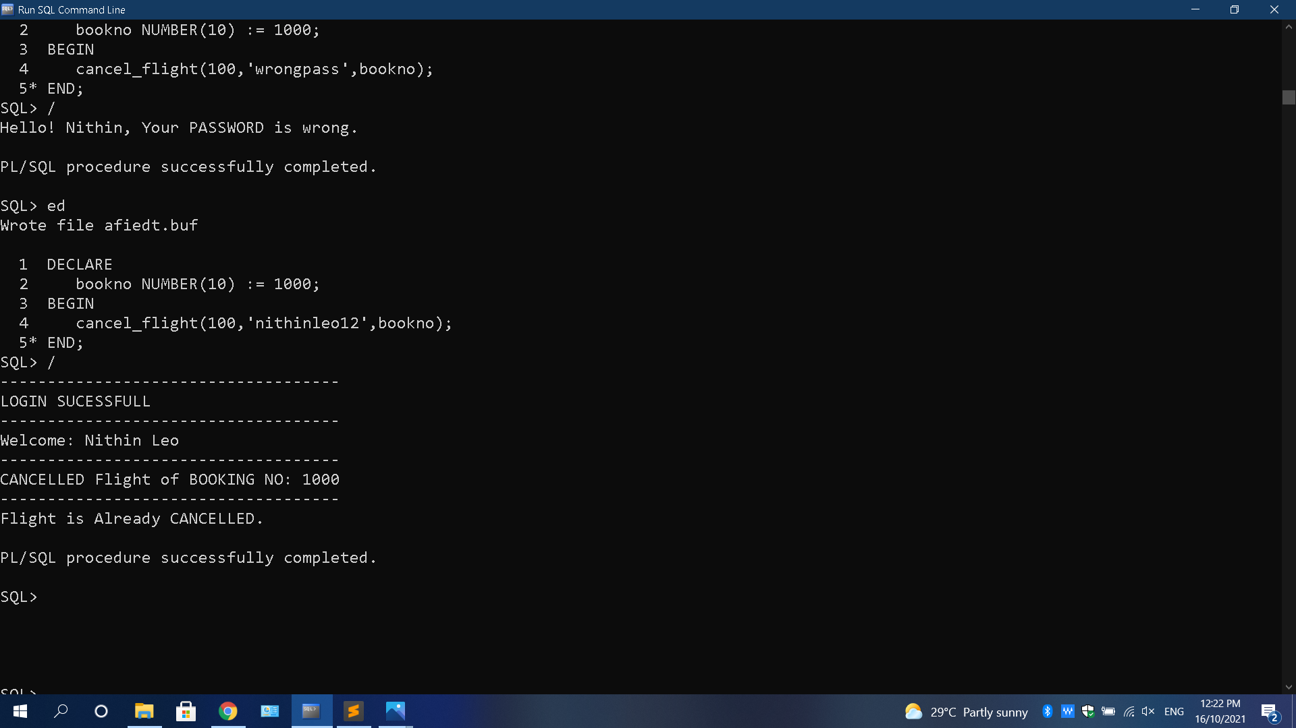
OUTPUT:-
-> Testing Output with Correct Inputs:
-> Testing Output with Correct Inputs Again:

Slide 45
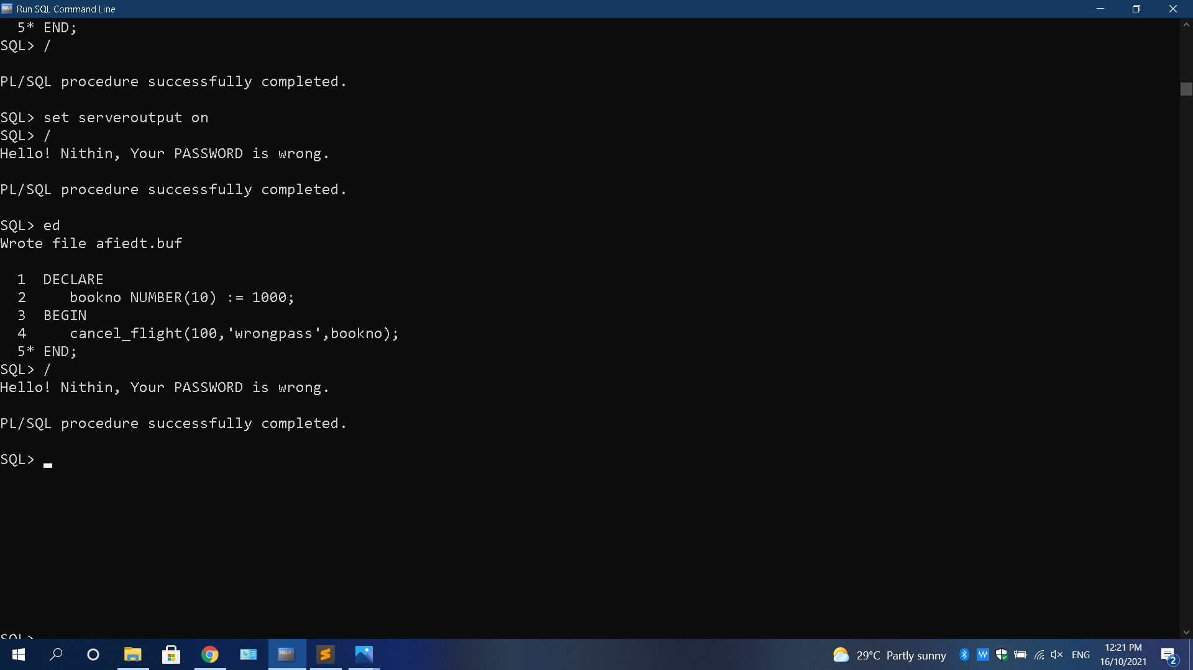
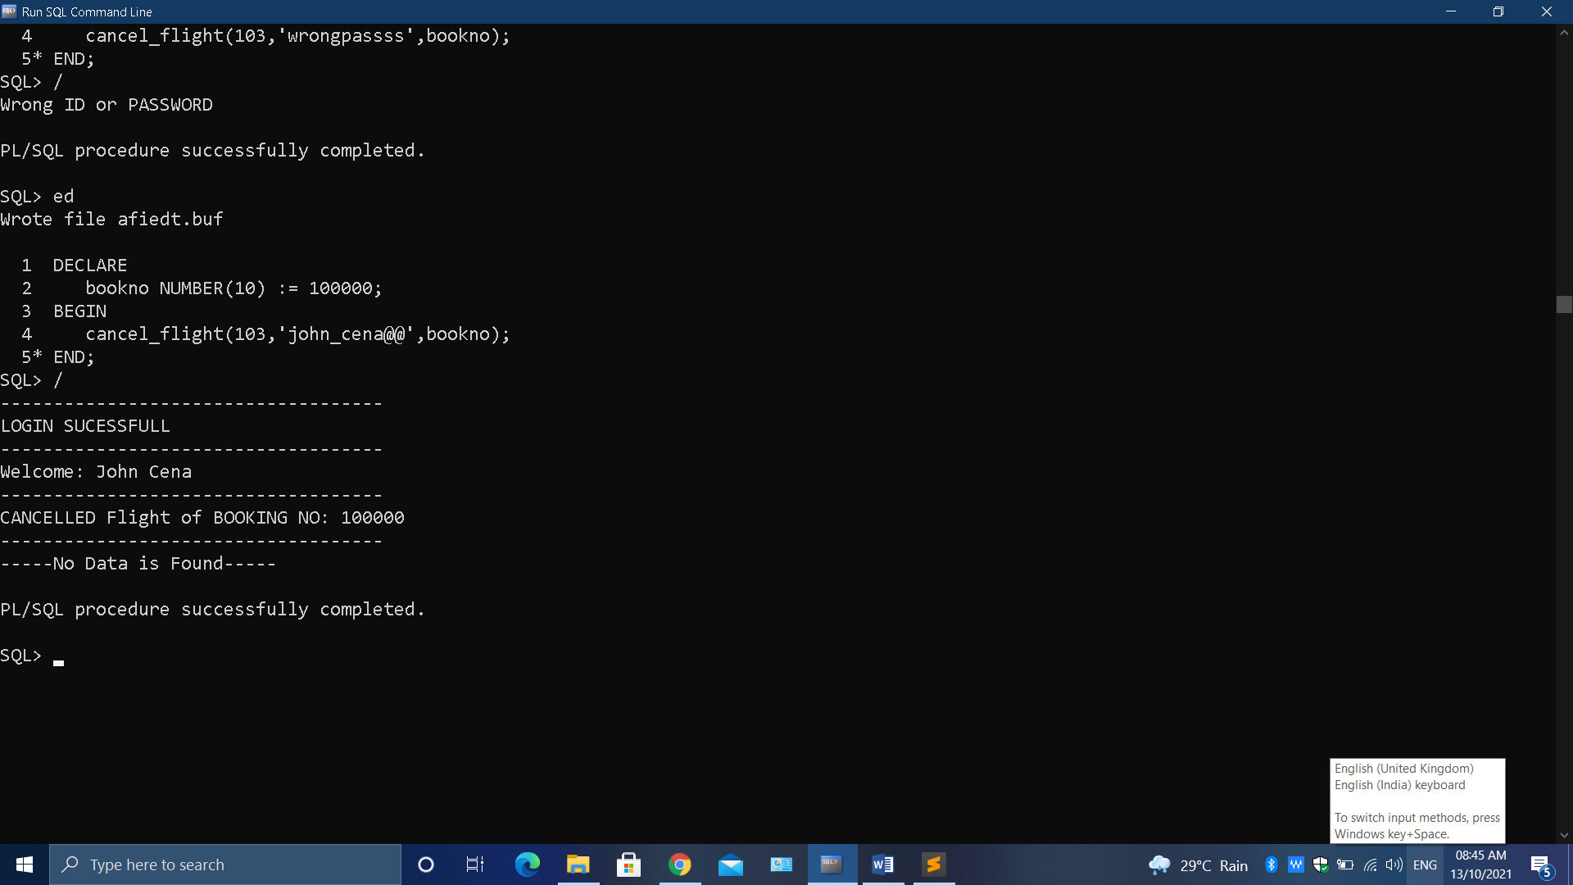
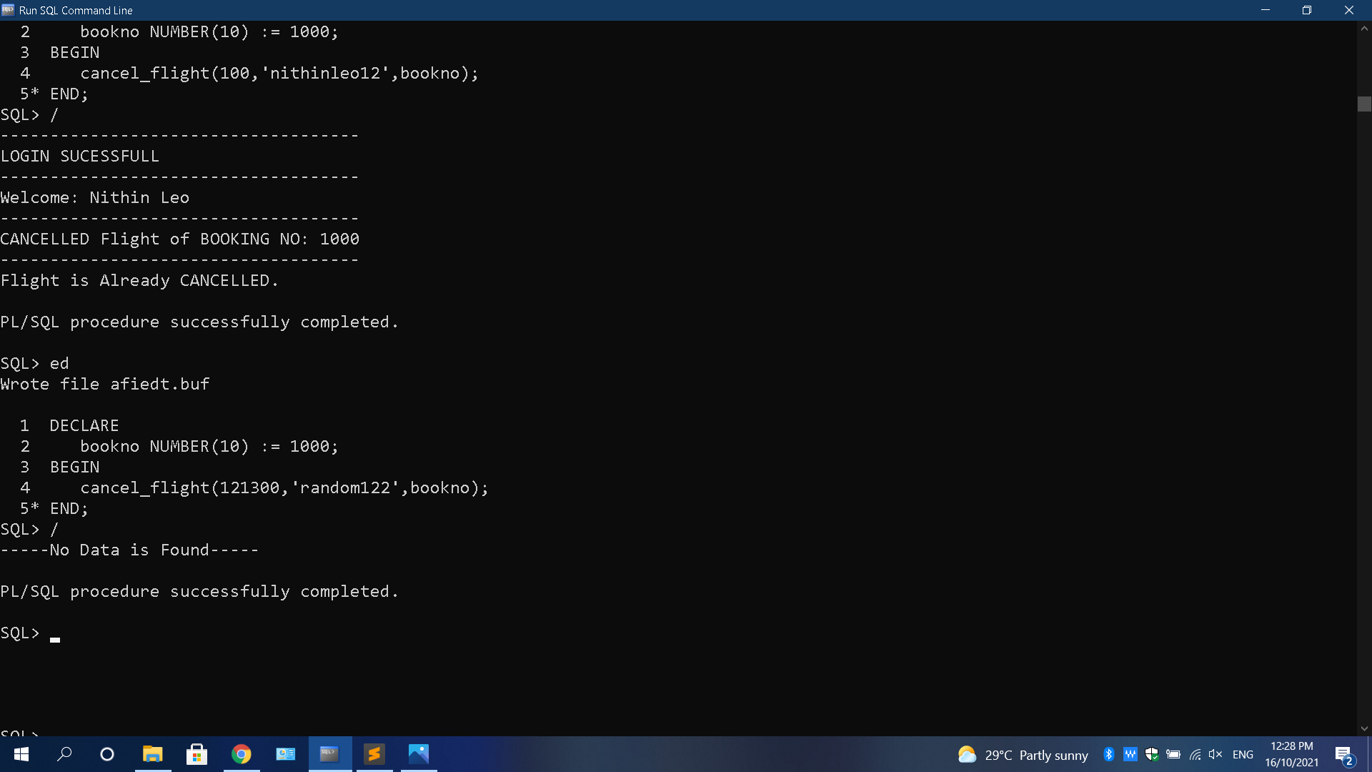
OUTPUT (Continue..):-
-> Testing Output with Wrong Password:
-> Testing Output with Wrong Booking_no:
-> Testing Output with Wrong Data:

Slide 46
SUMMARY
Created TABLE’s as per ER Diagrams with required Constraints.
Inserting Data into those Tables.
Displaying the number of bookings, emails, phone & fax numbers for customer based on their customer_id.
Displaying Customer details using their customer_id as Input to parameter.
Displaying the list of Customer’s who did not place any single bookings.
Displaying the list of Customer’s who have cancelled their bookings.
Created a Procedure by which Customer will be able to Book a Flight.
Created a Procedure by which Customer will be able to Cancel the Flight.

Slide 47


